Slide 1
Project 1
Helal El-Zaatari
10/07/2019

Slide 2
Main Goals
Want to know whether the amount of food ( in pounds ) varies as the months change
Will be able to predict whether certain months experience more demand of food so that the shelter will be able to anticipate such demand.

Slide 3
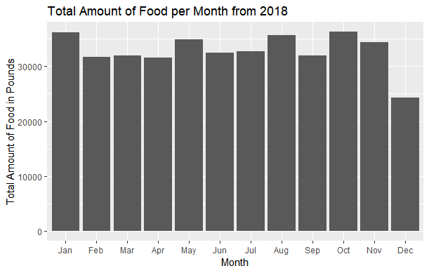

Slide 4
Analysis on Food
We can’t really infer anything from a year to year basis as the variance from each sample is high.
Let’s look at a bar graph from the year 2009.

Slide 5
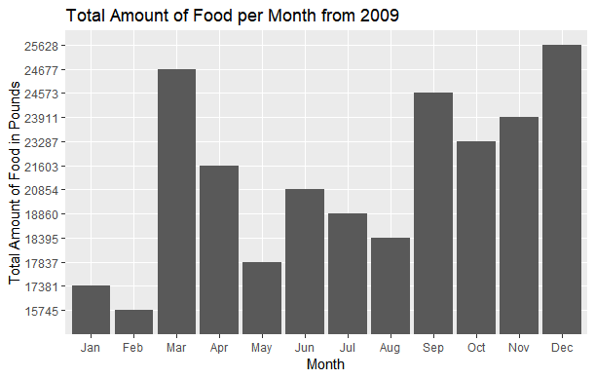

Slide 6
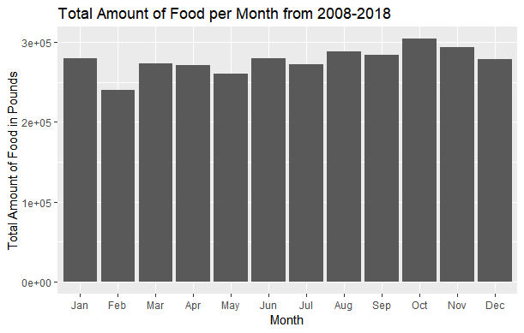

Slide 7
Comments on Graph
The average of food amount ( in pounds ) per month was 277073 pounds per month for the years 2008-2018.
We see that the months of February and October experienced food amounts which were significantly lower and higher than the average respectively.

Slide 8
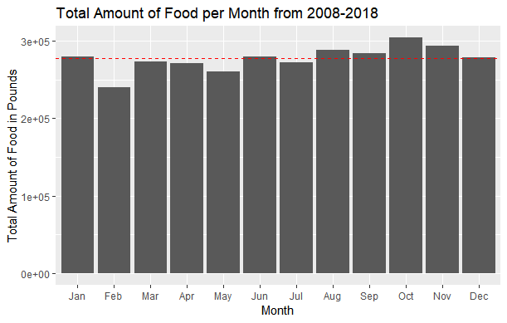

Slide 9
Comments on February and October
The amount of food in February was 14% lower than the average.
The amount of food in October was 10% higher than the average.
Standard deviation for the months February and October were 5037 and 6355 respectively. Means were 21850 and 27635 respectively.

Slide 10
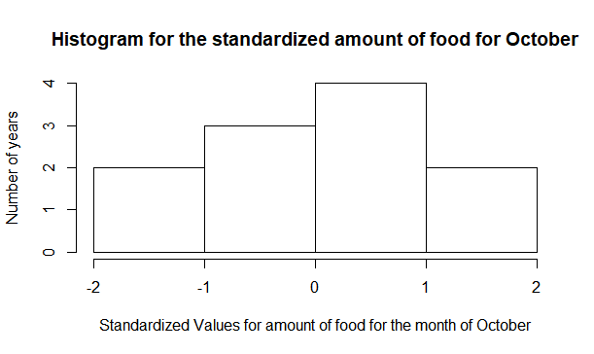

Slide 11
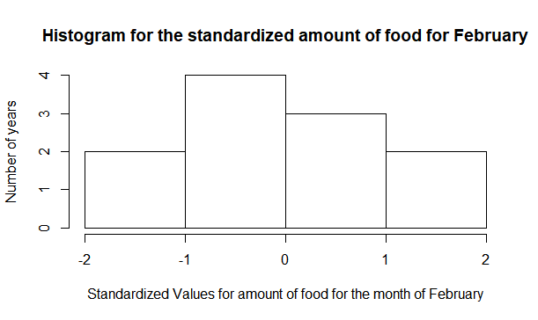

Slide 12
Data Source
:https://raw.githubusercontent.com/biodatascience/datasci611/gh-pages/data/project1_2019/UMD_Services_Provided_20190719.tsv

